Slide 1
Architecting Hybrid Solutions

Slide 2
Agenda
Extending the network
Extending AD to Azure
SQL Server DR to Azure
Backup to Azure storage
Azure Site Recovery
Extending storage to the cloud via StorSimple

Slide 3
Extending the Network and AD

Slide 4
Hybrid Solution Network Requirements
 | Site-to-Site VPN | ExpressRoute - Exchange Provider | ExpressRoute - Network Service Provider
Bandwidth | <100 Mbps | Up to 10 Gbps | Up to 1 Gbps
Typical Use Cases | Dev / test / lab small scale production | Enterprise-class and mission critical workloads Backup Azure as a DR site | Enterprise-class and mission critical workloads Backup Azure as a DR site
Notes:
To extend an on-premises data center to the cloud, we need to first extend the network. There are two primary options:
Virtual Network Site-to-site A site-to-site VPN allows you to create a secure connection between your on-premises site and your virtual network. We use industry standard IPsec VPN in Azure. So we are interoperable with most VPN devices. You can refer to a list of known compatible devices and sample configurations in the Azure website. You can use this service to connect up to 10 on-premises sites and virtual networks to each other securely. Once a site-to-site VPN is setup you have IP level connectivity between your premises and virtual networks in Azure. This enables you to build truly hybrid applications in Azure. Use this service in cases where your cross-premises connectivity throughput is nominal (~ 100 Mbps).
ExpressRoute ExpressRoute lets you create private connections between Azure datacenters and infrastructure that’s on your premises or in a co-location environment. ExpressRoute connections do not go over the public Internet, and offer more reliability, faster speeds, lower latencies and higher security than typical connections over the Internet. With ExpressRoute, you can establish connections to Azure at an ExpressRoute location (Exchange Provider facility) or directly connect to Azure from your existing WAN network (such as a MPLS VPN) provided by a network service provider. You can learn more about ExpressRoute from this blog post.

Slide 5

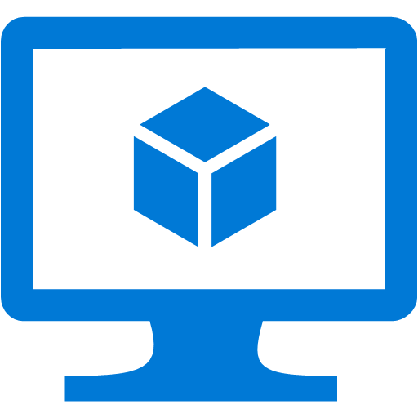

Replicating WinServer AD DS to Azure
Cloud Deployment (New AD)
Create New VM
Configure Data Disk for ReadOnly Cache Mode
DC Promo and replicate existing on-premises AD
Add Domain New Forest
Place database (.dit) on Data Disk
Cloud Deployment (Existing AD)
Upload Existing Domain Controller VHD(s)
Create New VM with VHD(s) attached
Configure Disk with .dit for ReadOnly Cache Mode
Azure VNET
Domain Controller
Domain controller
AD replication over Site-to-site or Express Route

Slide 6
SQL Server DR on Azure Options
Notes:
45 min left
We will discuss three common patterns for on-premises SQL Server DR to Azure and commonly thought of as Cold, Warm, and Hot backup/recovery models”
Backup directly to Azure storage and restore to a VM at time of need - COLD
Log-ship to standby SQL Server instance on Azure - WARM
SQL AlwaysOn asynchronous availability replica on Azure - HOT
Which options to choose depends on the RPO, RTO requirements. Let’s explore each option in more detail

Slide 7
SQL Server Recovery Options
Cold standby. A secondary data center that can provide availability within hours or days
SQL Backup to Azure
Warm standby. A secondary data center that can provide availability within minutes or hours
SQL Log Shipping
Hot standby. A nearby secondary instance that can provide availability within seconds or minutes and another remote replica for DR with longer recovery time
SQL AlwaysOn Availability Group

Slide 8
Cloud Backup Benefits
Decrease reliance on tape backup to save money and increase agility
Have confidence in the safety of your data with Azure’s cutting-edge security, privacy, and compliance practices
Decrease the management overhead of backup processes with automation
Reduce the dependence on offsite tape backup to accelerate recovery time
Long term retention 99+ years

Slide 9
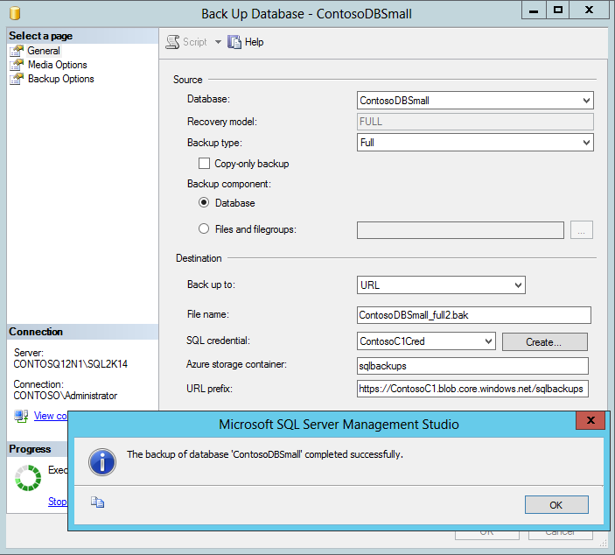
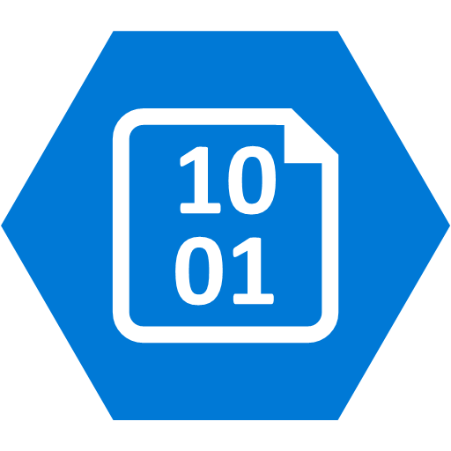

SQL Backup to URL (Azure Storage)
SQL DB
Azure Blob Storage
SQL DB
Notes:
Reference blog: https://technet.microsoft.com/en-us/library/jj919148%28v=sql.110%29.aspx?f=255&MSPPError=-2147217396
Key points about backing up DBs to Azure
URL: A URL specifies a Uniform Resource Identifier (URI) to a unique backup file. The URL is used to provide the location and name of the SQL Server backup file. In this implementation, the only valid URL is one that points to a page Blob in a Windows Azure storage account. The URL must point to an actual Blob, not just a container. If the Blob does not exist, it is created. If an existing Blob is specified, BACKUP fails, unless the “WITH FORMAT” option is specified.
If you choose to copy and upload a backup file to the Windows Azure Blob storage service, use page blob as your storage option. Restores from Block Blobs are not supported.
Credential: A SQL Server credential is an object that is used to store authentication information required to connect to a resource outside of SQL Server. Here, SQL Server backup and restore processes use credential to authenticate to the Windows Azure Blob storage service. The Credential stores the name of the storage account and the storage account access key values. Once the credential is created, it must be specified in the WITH CREDENTIAL option when issuing the BACKUP/RESTORE statements.

Slide 10
SQL backup to Azure – Things to Know
Requires an Azure subscription and Storage Account
An Azure blob storage container
SQL versions prior to SQL Server 2012 SP1 CU2 requires the SQL Server Backup to Azure tool
Notes:
Need to change picture and check for the agent info
https://msdn.microsoft.com/en-us/library/jj919148.aspx
SQL backup agent info here: http://www.microsoft.com/en-us/download/details.aspx?id=40740
SQL Server 2012 SP1 CU2 and SQL Server 2014 have built in capability to back up to Windows Azure storage. The SQL Server Backup to Windows Azure tool provides the same functionality for previous versions of SQL Server. It can also be used to provide encryption and compression for your backups.
Manage your backups to Microsoft Azure: Using the same methods used to backup to DISK and TAPE, you can now back up to Microsoft Azure storage by specifying URL as the backup destination. You can use this feature to manually backup or configure your own backup strategy like you would for a local storage or other off-site options. This feature is also referred to as SQL Server Backup to URL. For more information, see SQL Server Backup to URL. This feature is available in SQL Server 2012 SP1 CU2 or later. This feature has been enhanced in SQL Server 2016 Community Technology Preview 2 (CTP2) to provide increased performance and functionality through the use of block blobs, Shared Access Signatures, and striping.

Slide 11
Storing SQL Server Backups in Azure Containers Limitations
Max file size 1 TB
No SSMS management of backup files
No SQL backup device (sp_adddumpdevice) via URL
No multi-stream backup
Can’t add backup to existing files
Backup file name <259 characters

Slide 12



SQL Server AG log-ship and transfer to Azure
Azure VNET
DR on Azure
DR SQL log-ship target
WSFC SQL AG Listener
Sync
Commit
Restore logs from URL
Azure page blob
SQL DB Prim. Replica WSFC node 1
SQL DB Sec. Replica WSFC node 2
Cluster FSW
SQL log restore job
SQL log backup job
Site-to-site or Express Route
Notes:
https://technet.microsoft.com/library/ms187103.aspx explains log shipping
NO log ship to URL (Azure storage) directly yet
SQL Server Log shipping allows you to automatically send transaction log backups from a primary database on a primary server instance to one or more secondary databases on separate secondary server instances. The transaction log backups are applied to each of the secondary databases individually. An optional third server instance, known as the monitor server, records the history and status of backup and restore operations and, optionally, raises alerts if these operations fail to occur as scheduled.
AG can combine with Log shipping. its about controlling the data movement and restore delay on secondary database in log-shipping. Here is list of reasons why someone would use AlwaysOn Availability Group and Log Shipping together. Reasons for the combination are:
Delayed Recovery – In Log-shipping we can have definite delay on secondary database. This would safe guard DBA from “oops!” and “was that the production server?” situations. Log shipping can control the delay of transaction log restore while Asynchronous secondary replica can not.
Single DR Server – Single Server can be used as multiple log-shipping pair’s destination.
Infrastructure – Server at DR site can’t be a part of current cluster due to infrastructure limitations.
Technical – Secondary server is already a part of different windows failover cluster. In availability group, we can’t have overlap of nodes by two windows clusters.

Slide 13
SQL Log-Shipping - Things to Know
Schedule log backup and ship offsite to meet RPO requirement
No direct log ship to Azure storage yet
Apply logs base on desired delay time
Test recovery to ensure RTO is met

Slide 14
SQL Server Availability Replica on Azure
Azure VNET
DR SQL DB Sec. Replica
WSFC SQL AG Listener
Sync
Commit
Site-to-site or Express Route
SQL DB Prim. Replica WSFC node 1
SQL DB Sec. Replica WSFC node 2
Asynchronous commit
Cluster FSW
Notes:
In this SQL DR solution, we have three nodes in a Windows Server Failover Cluster stretched across two premises.
The two nodes on-premises offers automatic failover and zero data loss with synchronous replication
The remote node on Azure serves as a DR replica. For performance consideration of the application, this replica uses asynchronous replication which has the potential of data loss when failover. The failover is manual.
Benefits:
Not only can customers protect against system failure to keep up with SLA, they can also minimize planned down time. With rolling upgrade and maintenance, all planned maintenance and upgrades can be performed during business hours without taking the primary instance down.

Slide 15
Azure AG Replica – Things to know
Network latency
Be careful about failing resources over via cluster manager
Manage SQL failover from AG Dashboard or TSQL
Infrastructure admin trained on AO AG

Slide 16
Recovery Services
Notes:
30 min left

Slide 17
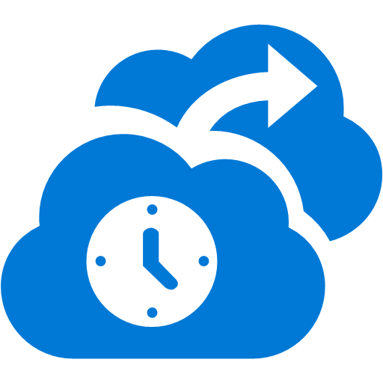
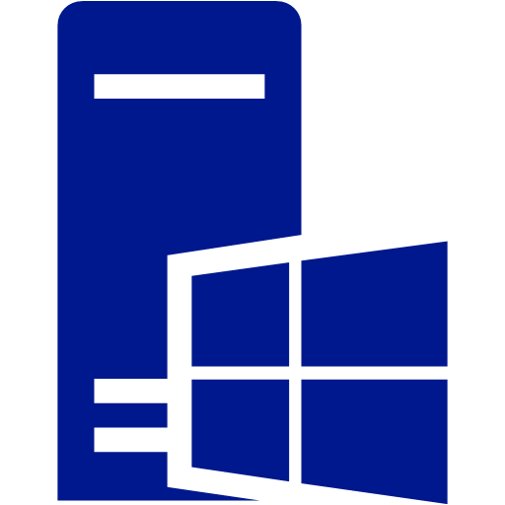
Azure Backup
Azure Backup
MS workload support
VmWare VM backup
Enterprise class data source support
Recover anywhere
Long term retention 99+ years
Azure
On-Premises
Backup/Restore
Notes:
Azure Integrated Backup Solution
Azure Backup protects your data in the cloud and optionally can be integrated with System Center Data Protection Manager for advanced workload protection.
Data protection schedules can be daily, monthly, weekly, and yearly with retention up to 99 years in Azure
Protects workloads running in Azure, in VMs, or on physical servers
Centralized monitoring and reporting across on premises and Azure
Advanced Workload Protection
Protects files and folders from Windows Servers and Windows Clients
Integrates with SCDPM protects enterprise workloads including SharePoint, Exchange, SQL Server, and Hyper-V VMs
Protects guest workloads running in VMware environments
DPM works seamlessly with the Hyper-V Volume Shadow Copy Services (VSS) writer to ensure that consistent versions of virtual machines are captured and protected without affecting virtual machine access
Granular restore capability such as mailbox recovery for Exchange, DB level recovery for SQL, and ILR for SharePoint
When setting up the Azure Backup Vault, selecting a region far away from your primary region is unnecessary. Azure Backup automatically copies the backup files to a remote region. So select a region close to your primary region for faster backups ??
Virtual machine backup is local. The backup vault from a specified Azure region will not allow you to backup virtual machines from another Azure region. Thus for every Azure region that has VMs that need backup, at least 1 backup vault must be created in that region.
Limitations for DPM backup to Azure
https://msdn.microsoft.com/en-us/library/azure/dn337337.aspx

Slide 18
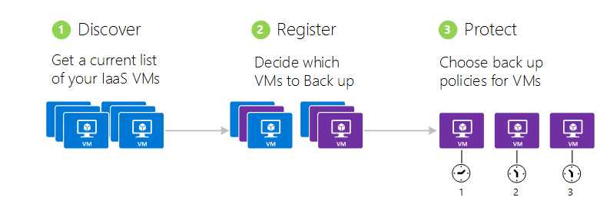
Azure Backup Steps
Notes:
Discover Azure virtual machines
The discovery process queries Azure for the list of virtual machines in the subscription, along with additional information like the Cloud Service name and the Region. The discovery process should always be run as the first step. This is to ensure that any new virtual machines added to the subscription are identified.
Register Azure virtual machines
Before a virtual machine can be protected it needs to be registered with the Azure Backup service. The primary goal of the registration process is to associate the virtual machine with the Azure Backup service. Registration is typically a one-time activity.
Protect: Backup Azure virtual machines
This step involves setting up a backup and retention policy for the virtual machine. Multiple virtual machines can be protected at scale using a single protect action.
See https://github.com/Azure/azure-content/blob/master/articles/backup/backup-azure-vms.md for more details

Slide 19
Azure Backup – Things to know
Supports 64-bits Windows Server and Windows clients
VM Backups are local to the region, need at least one vault per region
Supports VMs with up to 16 disks plus the OS disk
Supports encrypted disks
VM backups can be retained up to 99 years
Maximum 25 backup vaults per subscription
Up to 50 machines or 100 Azure VMs per vault

Slide 20
Azure Backup
Notes:
See demo script: 2.Demo_AzureBackup.docx

Slide 21
Azure Site Recovery

Slide 22


Azure Site Recovery One solution for multiple infrastructures
Replication
Replication
SAN
SAN
Replication
Microsoft Azure
Hyper-V
Hyper-V
Hyper-V
Hyper-V
Hyper-V
1
Hyper-V to Hyper-V (on-premises)
2
Hyper-V to Hyper-V (on-premises)
3
Hyper-V to Microsoft Azure
Replication
Replication
Microsoft Azure
VMware or Physical
VMware
VMware or Physical
4
VMware or Physical to VMware (on-premises)
5
VMware or Physical to Microsoft Azure
Notes:
Protection between two datacenters with VMM
Protection between two datacenters with VMware
Protection between a datacenter with VMM and Azure
Protection between a Hyper-V site and Azure
Protection between an on-premises physical server or VMware virtual machine and Azure
Protection between Amazon Web Services and Azure (Windows AMIs only)* (Note showed on diagram)
Migration between Azure regions and subscriptions*
Azure to Azure is only supported for migration, NO DR as of 1/12/2016

Slide 23
On-Premises Hyper-V to Azure DR ASR Example without VMM
Notes:
See https://azure.microsoft.com/en-us/documentation/articles/site-recovery-components/ for details

Slide 24
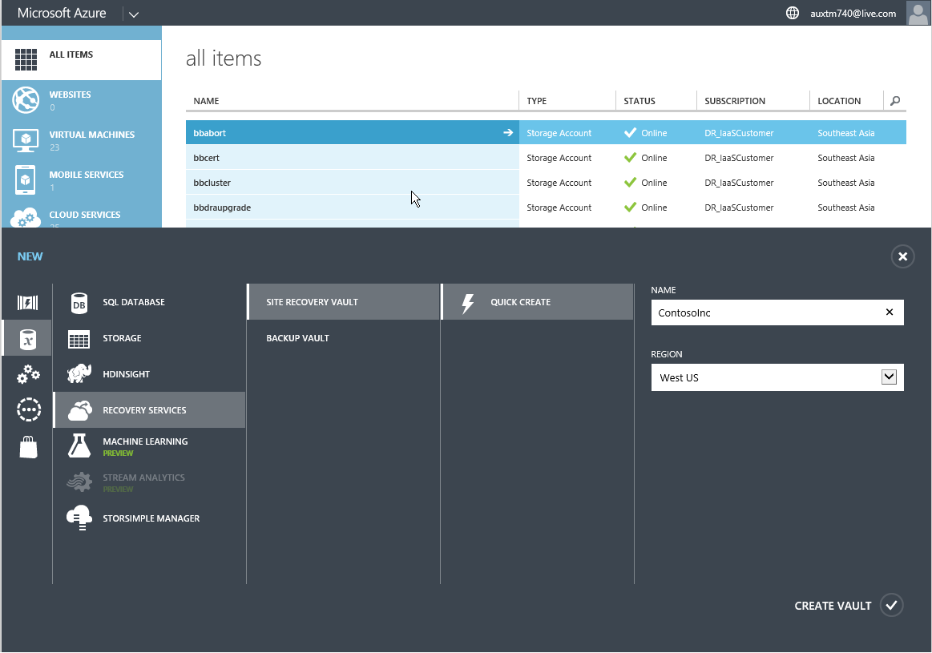
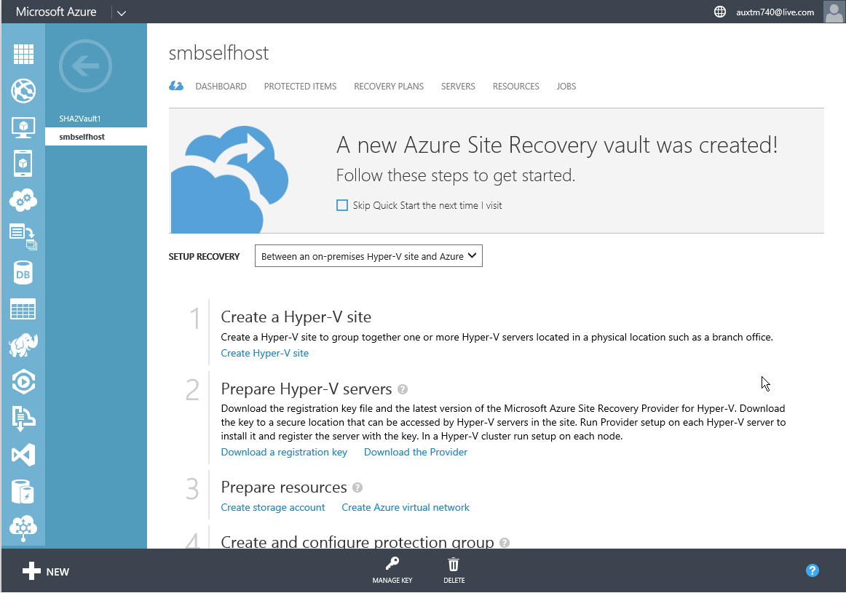
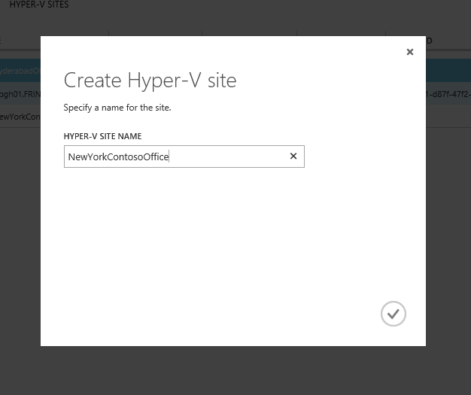
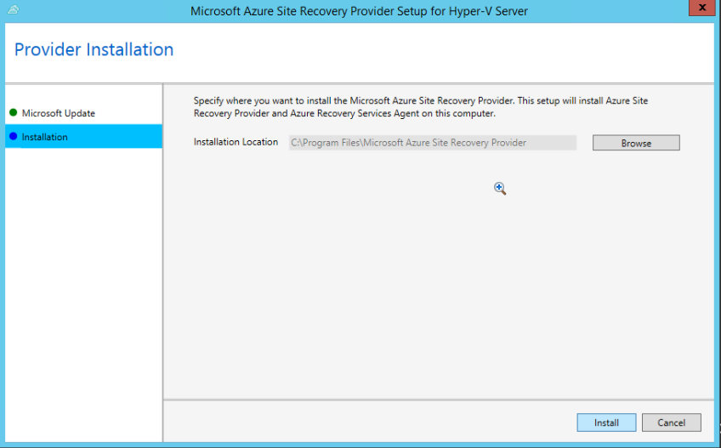
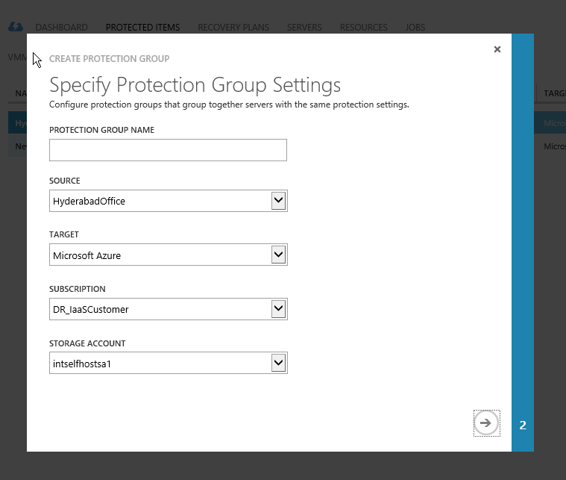
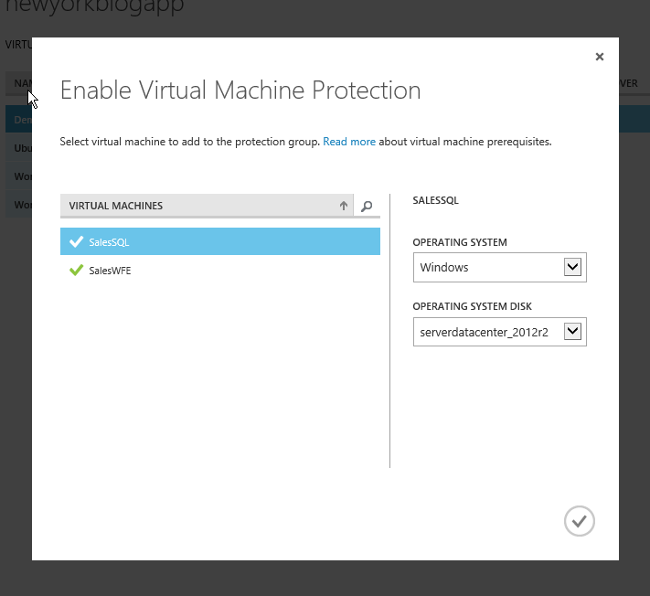
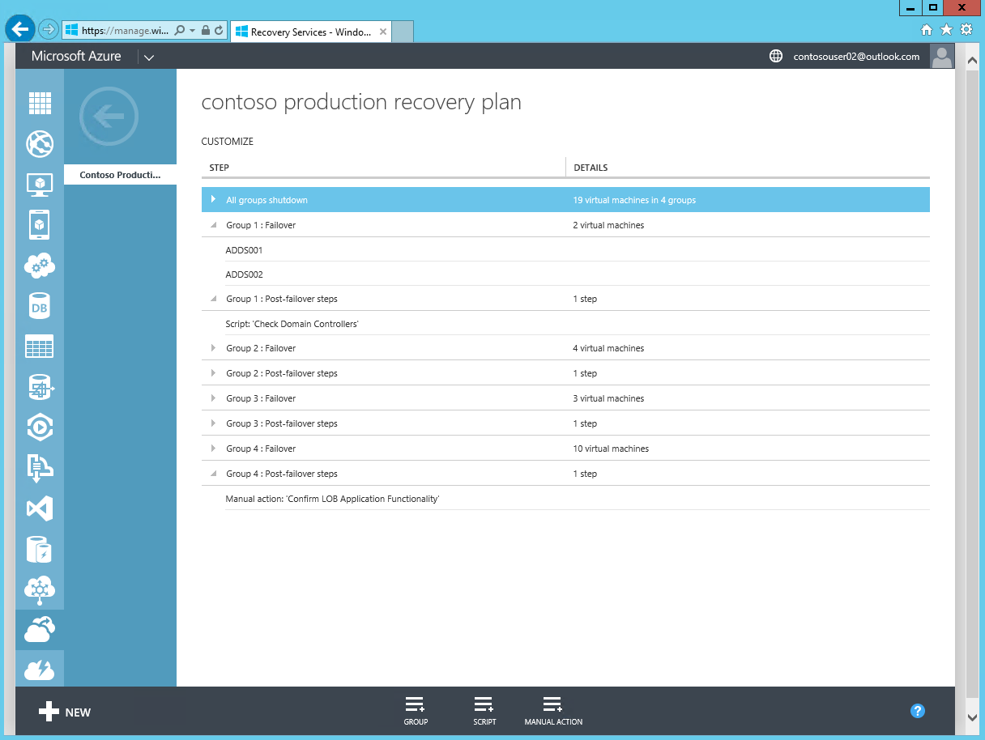
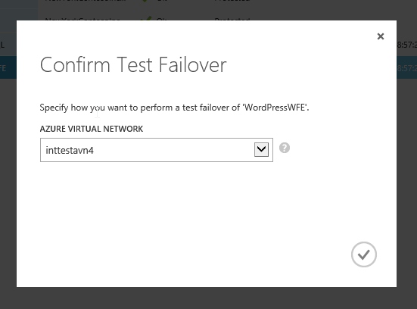
ASR Configuration
1
2
3
4
CREATE VAULT
QUICK START
CREATE SITE
REGISTER
Customer selects recovery region
View step-by-step guidance
A group for servers to represent Site or Branch.
Register Hyper-V Server
5
6
7
8
CONFIGURE PROTECTION
PROTECT VIRTUAL MACHINES
CREATE RECOVERY PLAN
RUN DR DRILL
Define protection policy
Replicate disks to Azure
Define DR Plan
Test the deployment
Notes:
- You will need the following on-premises:
Hyper-V server: At least one Hyper-V host server. The Azure Site Recovery Provider and the Microsoft Recovery Services agent will be installed on each Hyper-V server. Virtual machines: At least one virtual machine running on the Hyper-V server. Nothing gets installed on the virtual machine.
You will need the below on Azure:
Site Recovery vault: At least one Azure Site Recovery vault (set up with a subscription to the Site Recovery service) Storage account: An Azure storage account under the same subscription as the Site Recovery service. Replicated machines are stored in Azure storage.

Slide 25
On-Premises VMWare to Azure DR ASR Example

Slide 26






VMware VMs and Physical servers
Process Server
Customer 1
Source: VMware vCenter VMs & Physical Servers
Microsoft Azure Site Recovery
Customer 1
Data Channel
Customer 2
Target: Microsoft Azure
Process Server
Source: VMware vCenter VMs & Physical Servers
Microsoft Azure
Microsoft Azure
Customer 2
Process Server – Used for Caching, Compression & Encryption
Config Server – Used for Centralized Management
Master Target – Used as a repository & for retention
Mobility Service – Captures all data writes from memory
Notes:
- To set up ASR for VMWare protection, below are what you need on-premises:
Process server: This server optimizes data from protected VMware virtual machines or physical Windows/Linux machines before sending it to Azure. It also handles push installation of the Mobility service component to protected machine, and performs automatic discovery of VMware virtual machines. VMware vCenter server: If you're protecting VMware VMs you'll need a VMwave vCenter server managing your vSphere hypervisors ESX server: If you're protecting VMware VMs you'll need a server running ESX/ESXi version 5.1 or 5.5 with the latest updates. Machines: If you're protecting VMware you should have VMware VMs with VMware tools installed and running. If you're protecting physical machines they should be running a supported Windows or Linux operating system. See what's supported. Mobility service: Installs on machines you want to protect to capture changes and communicate them to the process server.
- What you need on Azure:
Configuration server: Standard A3 Azure VM that coordinates communication between protected machines, the process server, and master target servers in Azure. It sets up replication and coordinates recovery when failover occurs. Master target server: Azure VM that holds replicated data from protected machines using attached VHDs created on blob storage in your Azure storage account. A failback master target server runs on premises so that you can fail back Azure VMs to VMware VMs. Site Recovery vault: At least one Azure Site Recovery vault (set up with a subscription to the Site Recovery service) Virtual network: An Azure network on which the configuration server and master target servers are located, in the same subscription and region as the Site Recovery service. Azure storage: Azure storage account to store replicated data. Should be a standard geo-redundant or premium account in the same region as the Site Recovery subscription.

Slide 27
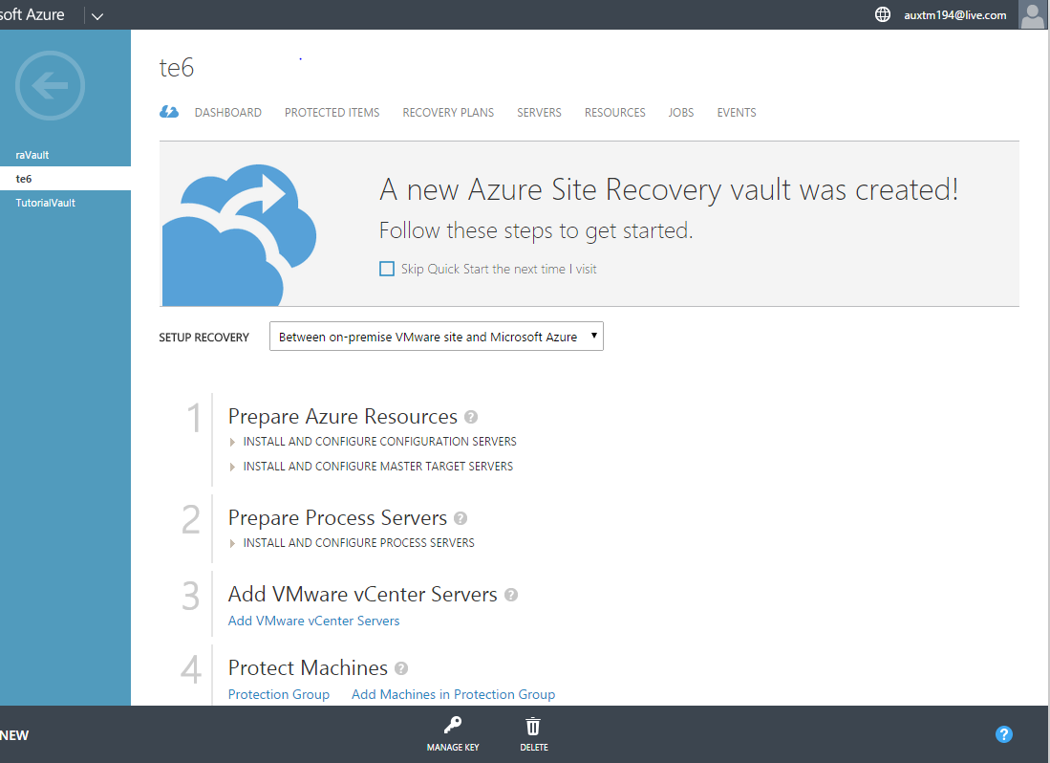
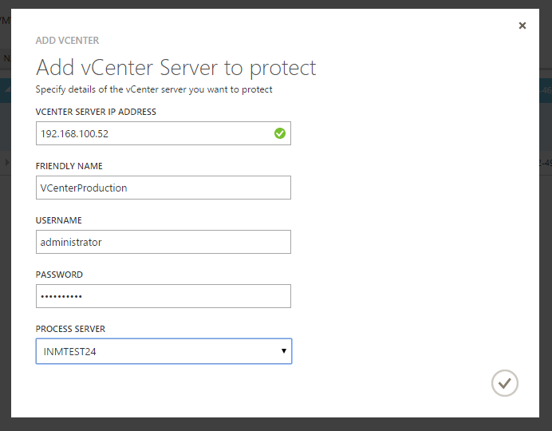
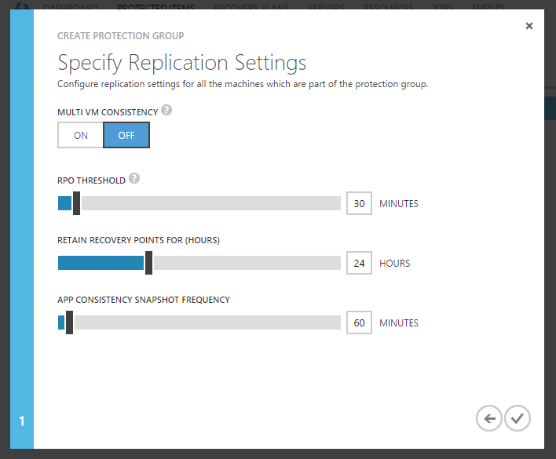
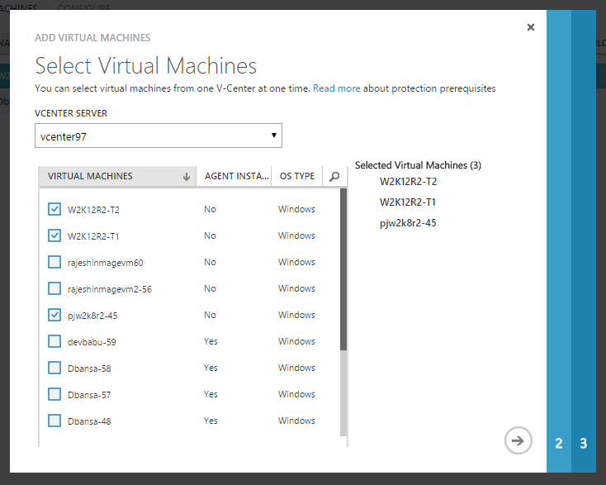
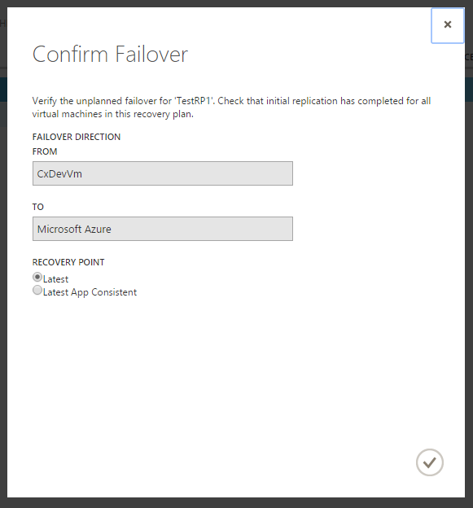
ASR Configuration
1
2
3
4
CREATE VAULT
QUICK START
SETUP SERVERS (PS, MT, CS)
REGISTER
Customer selects recovery region
View step-by-step guidance
Servers needed for guest replication
Register VCenter Server
5
6
7
8
CONFIGURE PROTECTION
PROTECT VIRTUAL MACHINES
CREATE RECOVERY PLAN
FAILOVER
Define protection policy
Replicate disks to Azure
Define DR Plan
Perform failover
Notes:
Follow the quick start to set up ASR configuration after creating the recovery vault. Considering what it takes in having an DR site on-premises, using Azure DR as a Service is much simpler and faster.

Slide 28
ASR – Things to know
Linux is supported at OS level, applications need to be tested at failover
ASR is available in ALL ‘non-government’ regions
ASR not in US GovCloud yet
Network bandwidth is key, ExpressRoute is a good idea
VM OS drive support limited to 1 disk up to 1TB in size
VM data disks supports up to 32 drives
Notes:
Considerations >> https://azure.microsoft.com/en-us/documentation/articles/site-recovery-vmware-to-azure-classic-legacy/
For old WS 2003 systems:
Windows Server 2003 32-bit and 2008 32-bit support on Azure for CSA customers
Customers must have migrations plans from Windows Server 2003 to more modern versions before deploying to Azure. Migration Only, not DR for now?
Ensure CS can communicate with MT, PS, and source
Configure endpoints and vNets after migration

Slide 29
Extending Storage to Azure

Slide 30


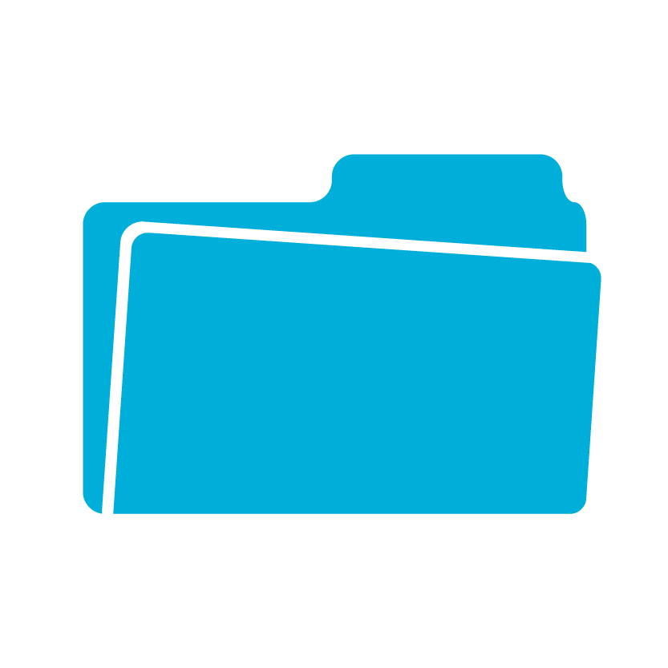


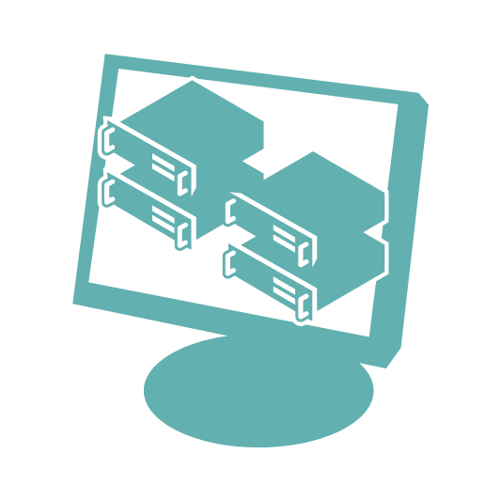


StorSimple on-premises & in the cloud
StorSimple connects Hyper-V, VMware and Linux servers to Azure Storage, seamlessly, with no application modification
Customer Data Center
Smaller Enterprise Environment
SAN
SAN
NAS
Enterprise
Hybrid
NAS or SAN
storage
Local or tiered volumes
Hyper-V
Hyper-V
Linux
Linux
VMware
VMware
SAN
StorSimple Physical
StorSimple Virtual Array
Automated offsite data protection using cloud snapshots
Highly efficient, location independent disaster recovery
Internet
Azure-based
Applications
iSCSI
Data mobility for enterprise data
Consolidated storage &
data management
StorSimple Cloud Appliance
StorSimple
Manager
Notes:
StorSimple is a hybrid storage device. It’s a storage device that you put in your data center and it instantly connect to Azure. It’s a small 2U device that speaks iSCSI that extends itself to Azure storage. It’s used for backup, archive as well as normal application storage.
StorSimple solutions integrate advanced SAN technologies such as SSDs, SAS, automated storage tiering, encryption, deduplication and compression with the cloud to reduce the storage footprint as well as CapEx and OpEx costs.
Benefits:
Manage data growth and lower storage costs up to 60%
Cloud storage is used to offload inactive data from on-premises and for storing backup and archive data
Inline deduplication and compression reduce storage growth rates and increase storage utilization
Solid state drives (SSD) deliver low-cost input/output per second
Streamline storage and management
Primary, backup, snapshot, archive and offsite storage are converged into a hybrid cloud storage solution
All storage functions are controlled centrally from an Azure management portal *
Automated cloud snapshots replace costly remote replication and time-consuming tape management
Improve disaster recovery and compliance
Instant recovery downloads only the data needed by applications for fast RTOs (recovery time objectives)
Data retention is determined by software policies instead of backup system capacity or tape rotations
Disaster recovery testing can be done without disrupting normal daily operations
Migrate and copy data through the cloud
StorSimple Virtual Appliance makes enterprise data available to VMs running in Azure for dev/test, disaster recovery and DR testing, and other cloud applications *
Data uploaded to the cloud can be accessed from other sites for recovery and data migrations

Slide 31

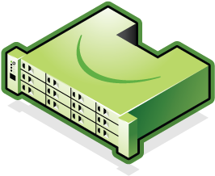
Consolidated Management
Azure StorSimple Manager
Registration Key
Service Data Encryption Key
On-Premises StorSimple_PhysicalAppliance
On-Premises StorSimple_VirtualArray *Preview
Azure StorSimple_VirtualAppliance
Notes:
With a StorSimple device installed at your data centre, you provision a StorSimple Manager on Azure. Work through the following steps to manage the on-premises device as well as the storage extension behind the storage appliance.
Get service registration key - You need a service registration key to register your devices.
Register the device - Go to the Windows PowerShell interface and use the service registration key to register your physical device and connect to StorSimple Manager service. Virtual devices are registered as part of device configuration.
Complete device configuration - After registering your device from the Windows PowerShell interface, complete the required device configuration from the device list. It may take a few minutes for the registered device to appear in the list.
The on-premises StorSimple Virtual Array available to all customers with an Enterprise Agreement for Microsoft Azure. The StorSimple Virtual Array is a version of the StorSimple solution in a virtual machine form installed on your existing hypervisors. The virtual array can be run as a virtual machine on your Hyper-V or VMware ESXi hypervisors and can be configured as a File Server (NAS) or as an iSCSI server.
StorSimple Manager service in Azure portal and manages one or more StorSimple appliances. All management of the hybrid storage include the on-premises devices, the Azure virtual device, backup catalog, jobs etc is done in one place (on Azure)

Slide 32
Azure RemoteApp
Azure
Remote Desktop Session Host deployed on cloud infrastructure services
Customizable with minimum capital expenditure
Windows Server session-based applications delivered from the Azure Cloud
Turnkey solution, scale without large CAPEX
Session-based computing
RDS
On IaaS
Azure RemoteApp
Notes:
This slide describes the evolution of RemoteApps
RemoteApp programs, which are programs that are accessed remotely through Remote Desktop Services and appear as if they are running on the end user's local computer. In Windows Server 2008 R2, Remote Desktop Services provides administrators the ability to group and personalize RemoteApp programs as well as virtual desktops and make them available to end users on the Start menu of a computer that is running Windows® 7. This new feature is called RemoteApp and Desktop Connection.
A Remote Desktop Session Host Remote Desktop Service (RDS), a protocol of Microsoft, allows users to connect remotely to a network with a graphic user interface. While the RDS client is installed on the user system, the RDS server software is installed on the server, and a remote connection is established with one or more terminal servers. While users in the RDS network connect to the server using a VM, this VM is shared with other users and operates on the same server operating system (OS) for all users.
(RD Session Host) server is the server that hosts Windows-based programs or the full Windows desktop for Remote Desktop Services clients. Users can connect to an RD Session Host server to run programs, to save files, and to use network resources on that server. Users can access an RD Session Host server by using Remote Desktop Connection or by using RemoteApp.

Slide 33
Two deployment options
RemoteApp cloud deployment
RemoteApp hybrid deployment
non domain join
domain join
Image available with Microsoft Office Professional Plus 2013 preinstalled
Rapid provisioning: apps quickly available
Automatic maintenance of platform image: OS and apps always up-to-date, Microsoft antimalware
User logon with Microsoft account or corporate credentials federated with Azure Active Directory
Fully customizable apps, OS, and settings
IT can manage template images and apply updates via Azure Portal
Full access to on-premises network
User logon with corporate credentials federated with Azure Active Directory
Requires a VNET to be configured and can be integrated with Azure AD Domain Services (AADDS)

Slide 34
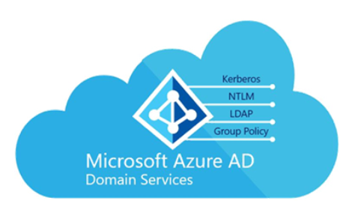




Cloud Only Deployment with AAD DS
RemoteApp Service
RDP
Published Apps
Elastic Runtime
Domain Joined
Session Hosts
GPOs applied
Domain Joined
Corporate Apps
File Server
Persistent user data (50GB per user)
Custom template image Maintained via Azure Portal
Files
LOB
Authentication
Azure Active Directory

Slide 35
Azure RemoteApp Hybrid Deployment
RemoteApp Service
RDP
Published Apps
Elastic Runtime
Subject to IT policy via GP, System Center, or other enterprise management tools
Domain Joined
Session Hosts
Corporate Apps
Azure VPN
Files
LOB
Persistent user data (50GB per user)
Custom template image Maintained via Azure Portal
Authentication
Azure Active Directory
Windows Server Active Directory
Azure AD Connect

Slide 36
RemoteApps Cloud Deployment

Slide 37
Summary
Key solution components for Hybrid IT
Extending the on-premises Network to Azure
SQL DR options
Backup
ASR

Slide 38
Enter link here

